Slide 1
ERP System For College Management
Group:-3

Slide 2
Team Members
Employee Id | Name
2491723 | Gadi Amrutha
2492768 | Ganesh Sharad Bahalkar
2492105 | Gowrabathina Siva Krishna
2491660 | Himansu Dash
2492370 | Jayesh X
2492304 | Jire Pritee Rameshrao
2491903 | K S Srikar Adithya
2492678 | Kalyani Prashant Shinde
2490048 | Kattula Deepthi Priyanka
2492632 | Kavipriya M

Slide 3
INDEX
Introduction
Project Scope
Requirement Specification
Modules of the system
Conclusion

Slide 4
introduction
College Management System is the one kind of web application which integrates all the modules and functionalities of college system on a single system that can be handle by the administrative and access by the faculties
And students with valid user id and password.
It can be helpful such that
Records are always updated.
Large amount of data regarding college and their modules can be stored.

Slide 5
Project Scope
The purpose of developing the collage management system is to automate the manual system to save time and expense.make the work fast and easy .
It is more efficient and convenient for the colleges.it reduces the man power or by reducing the paper works needed.
Save time
Storing and receiving information is easy.
Easy searching of college and student information.

Slide 6
Software Requirement

Slide 7

FRONTEND

Slide 8


BACKEND
MySql
Spring-Boot

Slide 9

Testing Tool

Slide 10
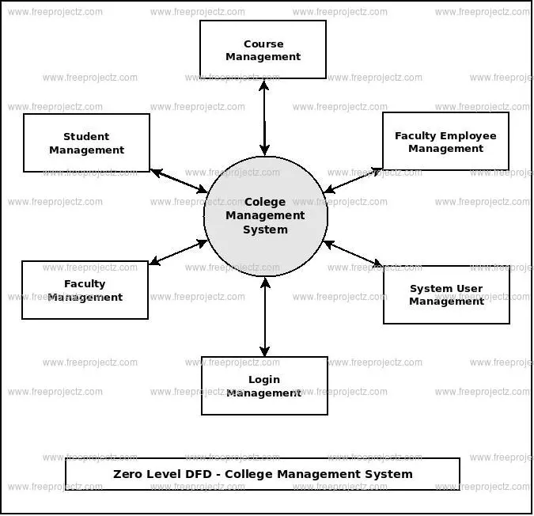
DFD(DATA FLOW DIAGRAM)

Slide 11
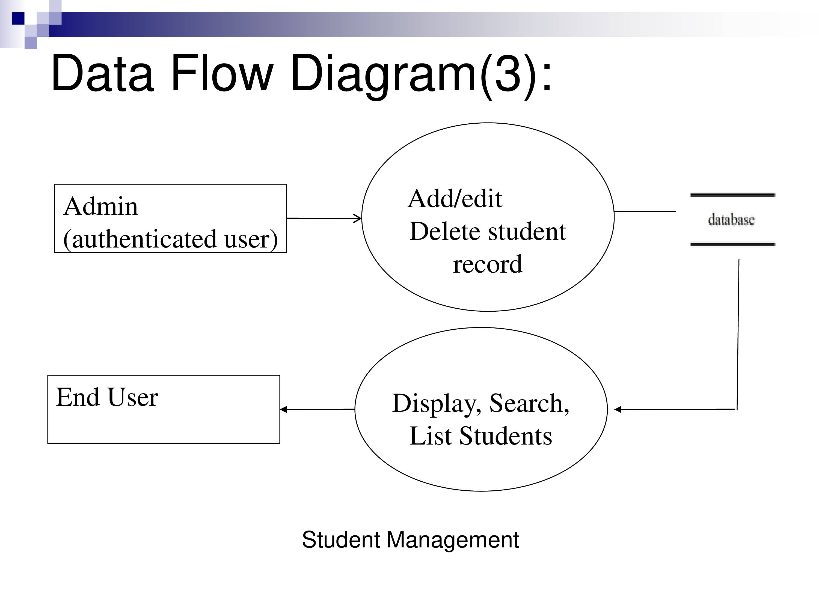
DFD(ADMIN)

Slide 12
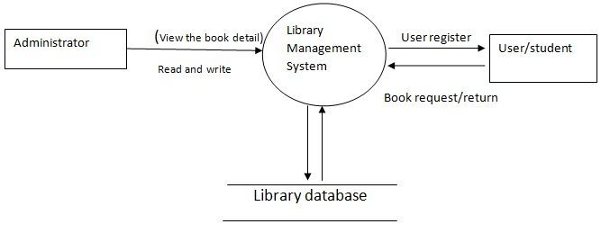
DFD(Library)

Slide 13


Slide 14
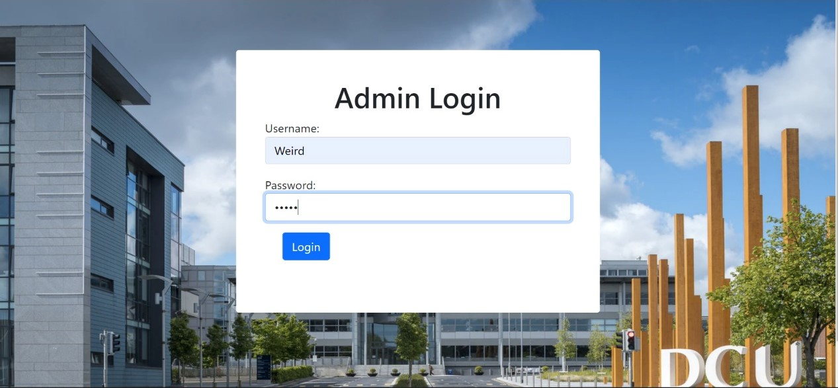

Slide 15
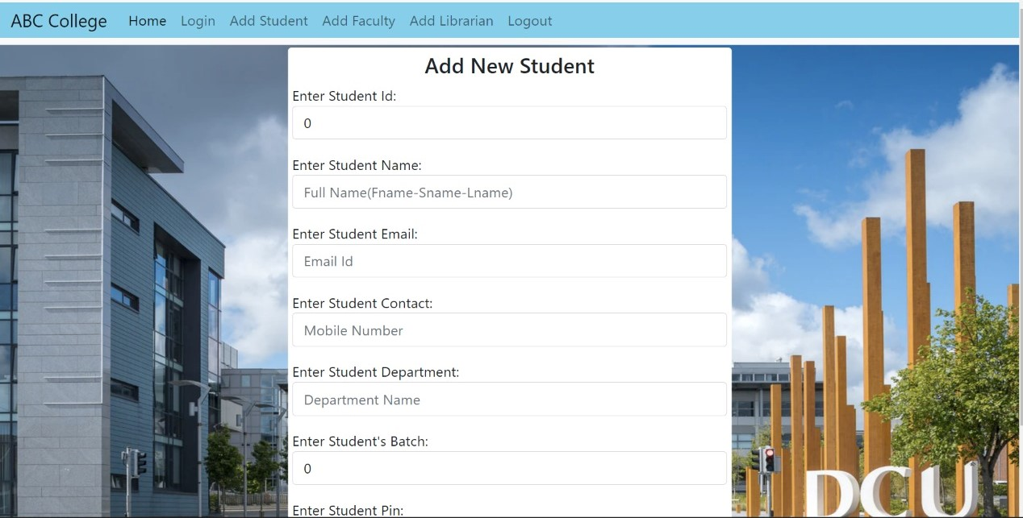

Slide 16
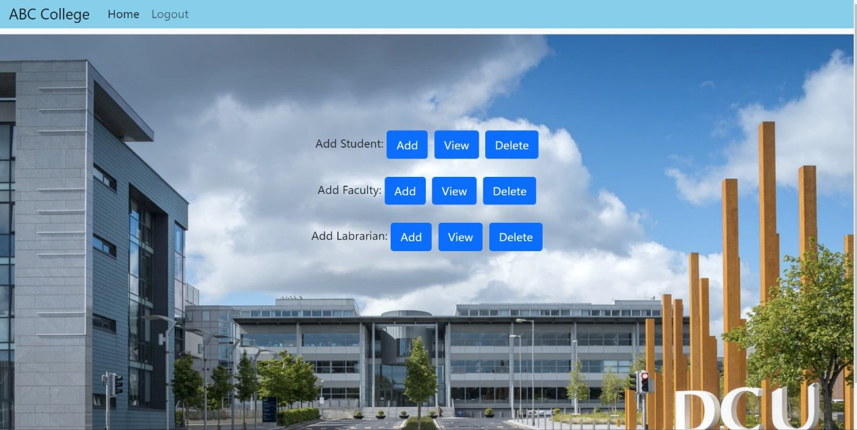

Slide 17
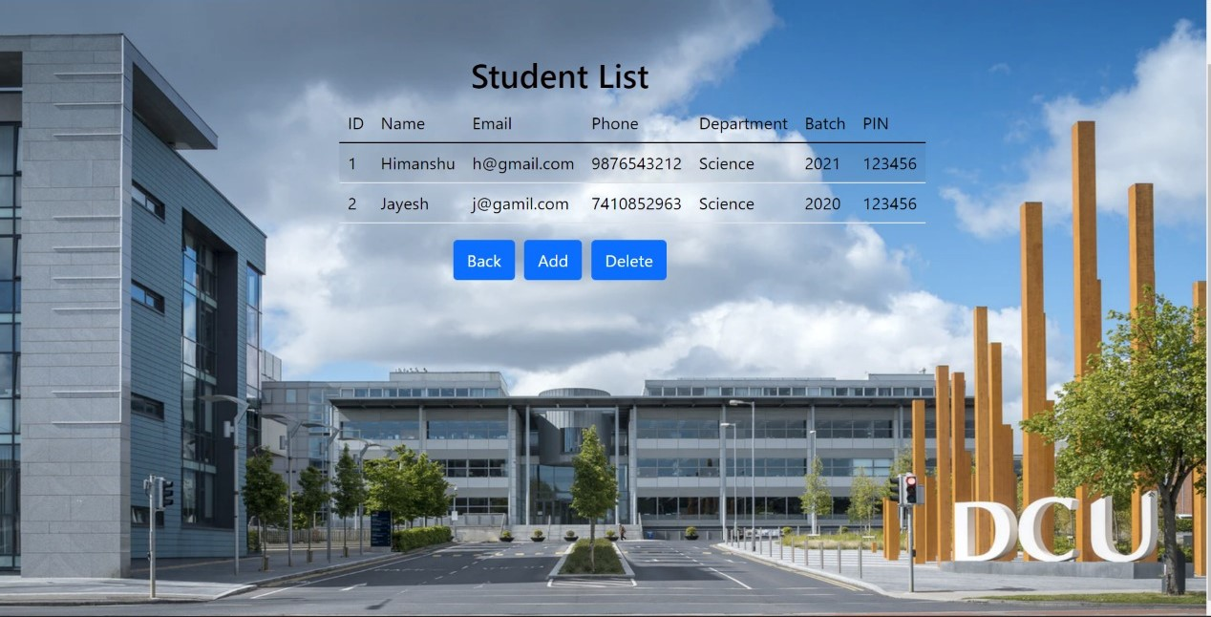

Slide 18
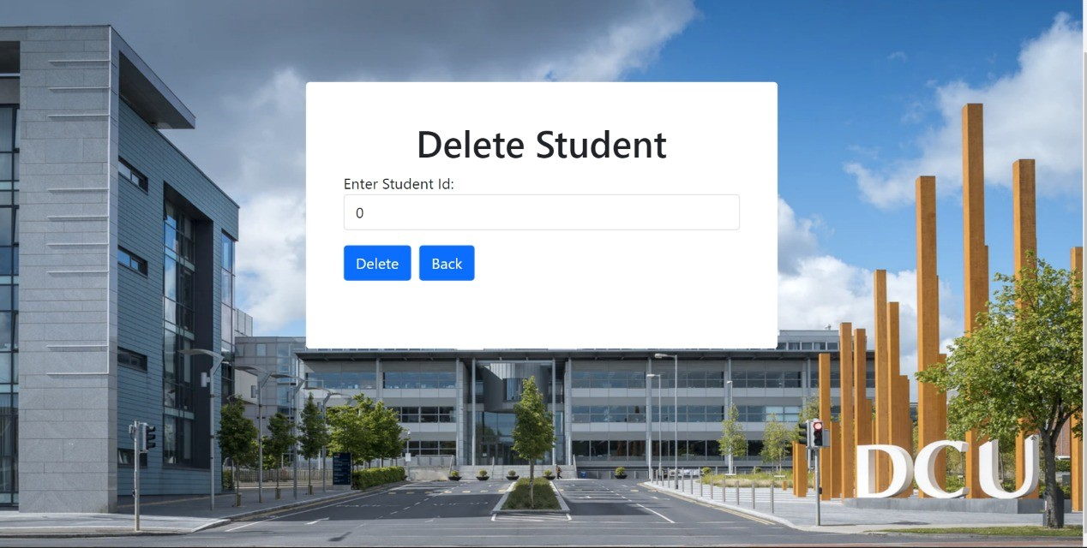

Slide 19
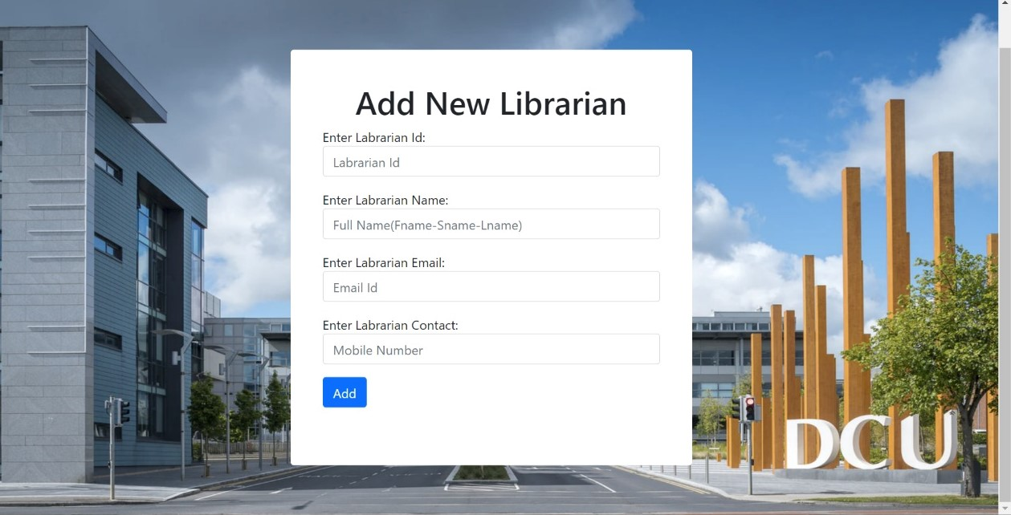

Slide 20
Project Scope
This project deals with the various functioning in College management process. The main idea is to implement a proper process to system .
In our existing system contains a many operations registration, student search, fees, attendance, exam records, performance of the student
It will helpful for teachers and students

Slide 21
Conclusion
The project entitled as College Management System is the system that deals with the issues related to a particular institution. This project is successfully implemented with all the features mentioned in system requirements specification. Awareness and right information about any college is essential for both the development of student as well as faculty. So this serves the right purpose in achieving the desired requirements of both the communities.

Slide 22


